Slide 1
UI Design & Implementation
Implementation of a Mobile Based Disaster Management System
UI
Course: Internet and Mobile Programming
Course Instructor: Dr. NKEMENI VALERY
Group 7

Slide 2
What we will cover
User Interface Design
Functionality
Implementation Details
Testing and QA
Deployment & Maintenance
1
2
3
4
5

Slide 3
User Interface & Design
1
Describing the overall layout of the app,design process, color schemes, typography, icons and other visual elements

Slide 4
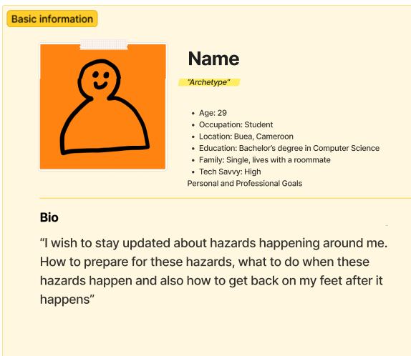
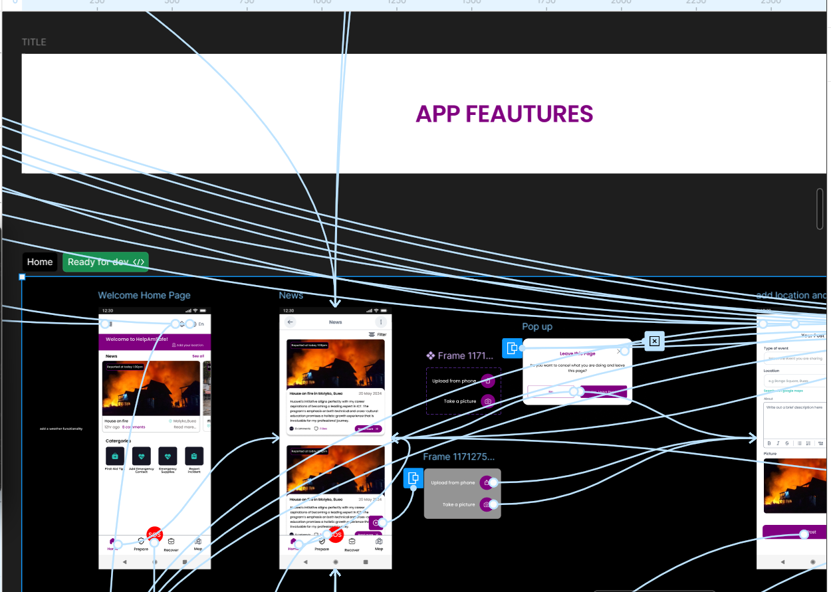


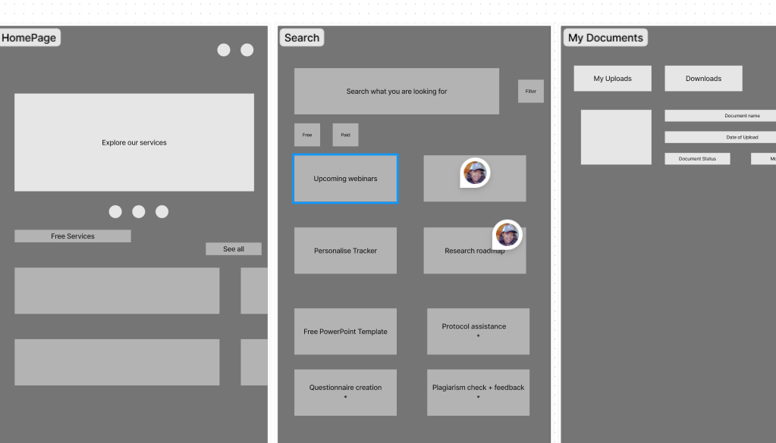
Design Process
A robust iterative design process was followed to ensure the disaster management app meets the needs of our users effectively. The process involved the following steps:
Research and Analysis
User Persona Development
Testing and Feedback
Wireframing
Prototyping
Comprehensive research was conducted which included studying existing apps, conducting user interviews, and analyzing feedback.
Based on research findings, user personas were created to represent different user groups and their specific requirements using figjam on Figma
Low-fidelity wireframes were created to visualize the app's layout and navigation structure. With paper sketches and lofi figma designs
High-fidelity prototypes were developed on figma to simulate the app's functionality and gather user feedback before implementation.
Regular feedback sessions and design reviews helped in identifying areas for improvement and making necessary adjustments.

Slide 5
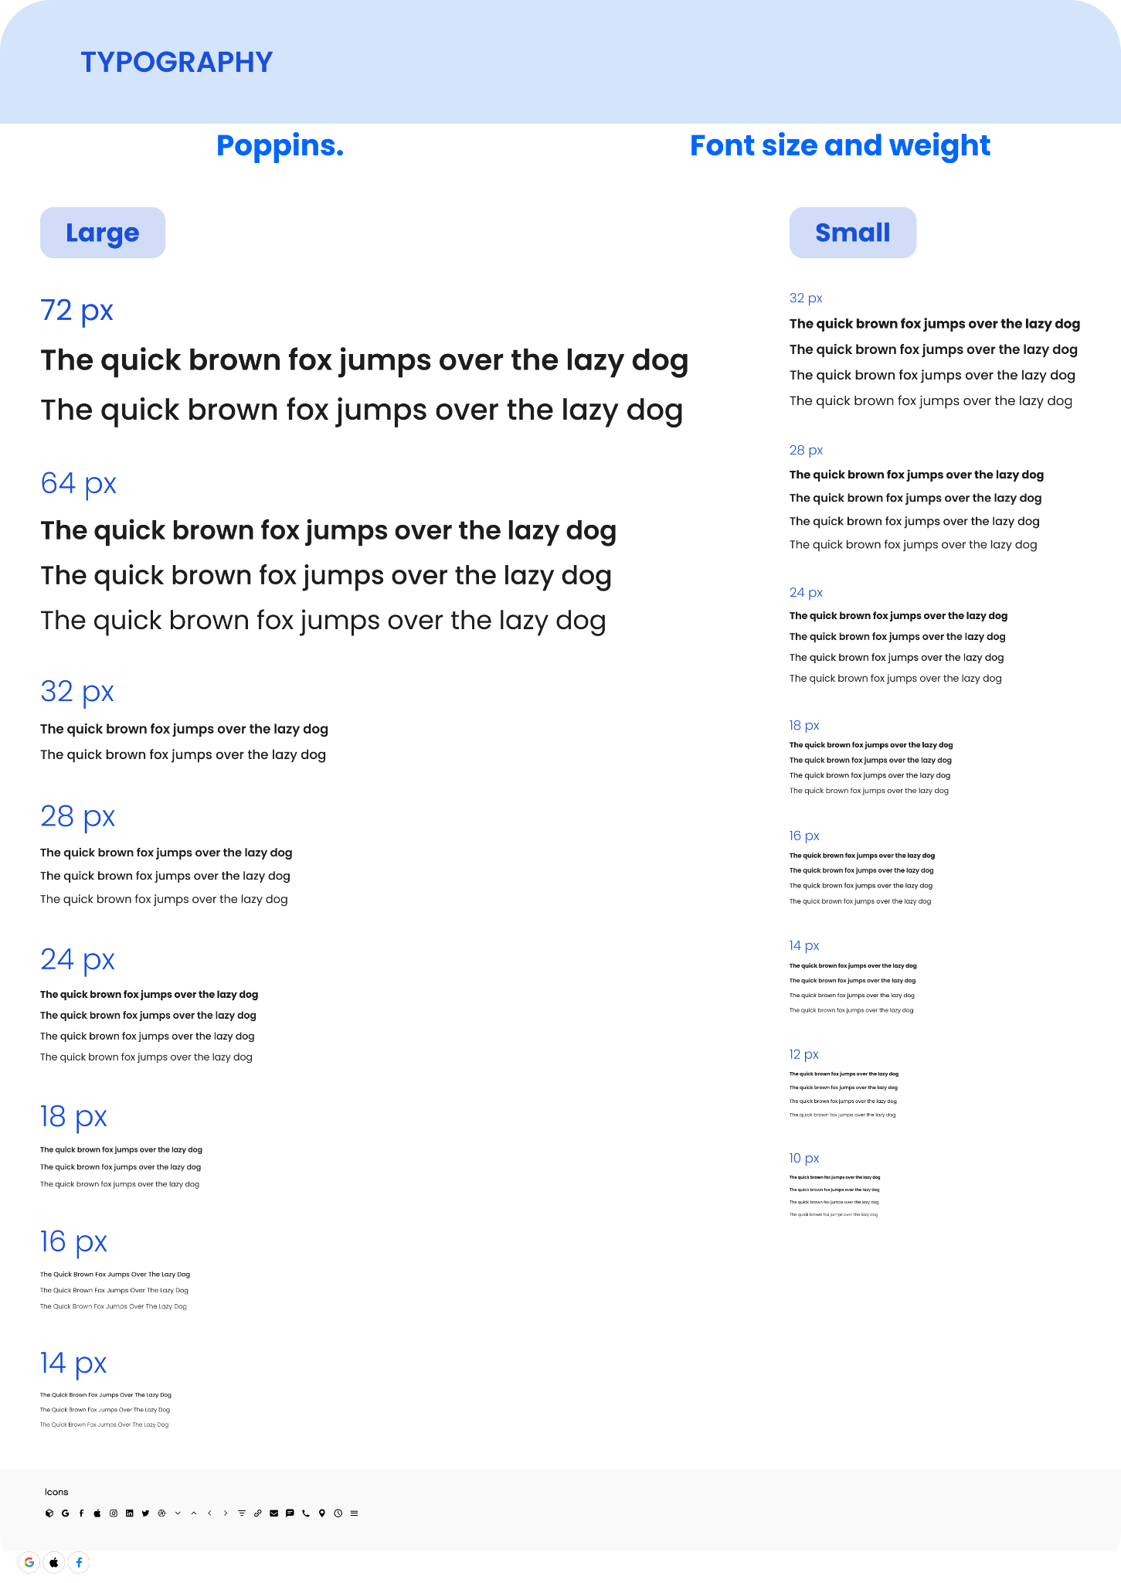
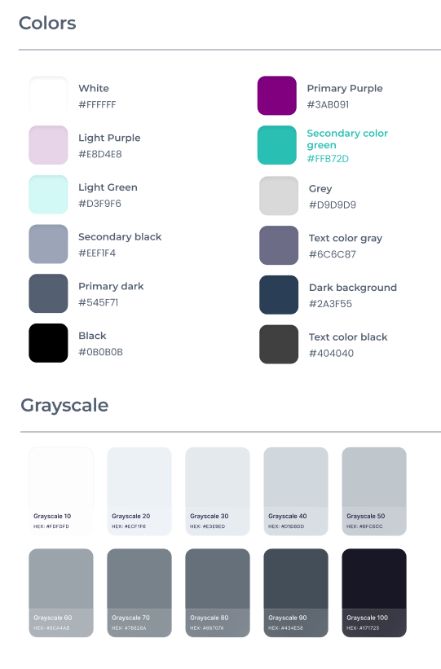
Visual Design
Visual design plays a crucial role in creating a cohesive and engaging user interface for our disaster management app.
Colour Scheme
We used #80080 and #2ABFB3 for calming and trustworthy feel. Sparingly used red for emergency buttons and to draw immediate attention. And light gray backgrounds for clean & minimalist aesthetic.
Typography
We used poppins for the font and simple flat icons (outlined and filled). And created reusable components in our design system.

Slide 6
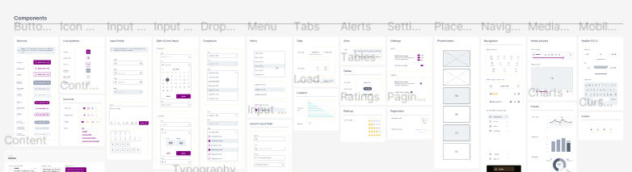
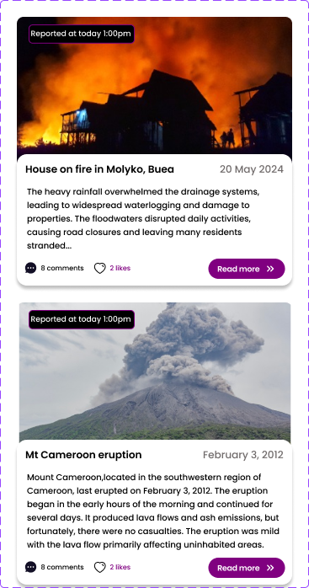
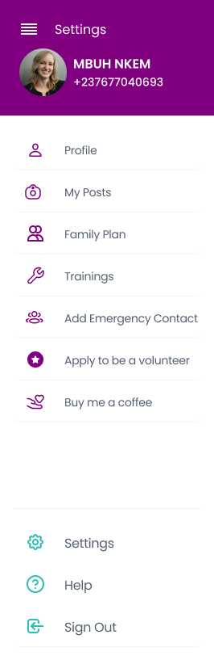
Other Visual elements
Others include creating our customizable design system, which contains reusable components and also using variants to create further components that were used frequently in the application.And also a wide range of assets such as images, svg files for better visual looks.

Slide 7
Functionality
2
Outlining the main features and functionalities of the app, describing how the app integrates with external systems.

Slide 8
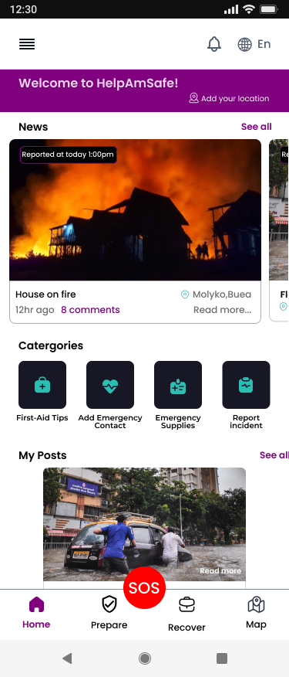
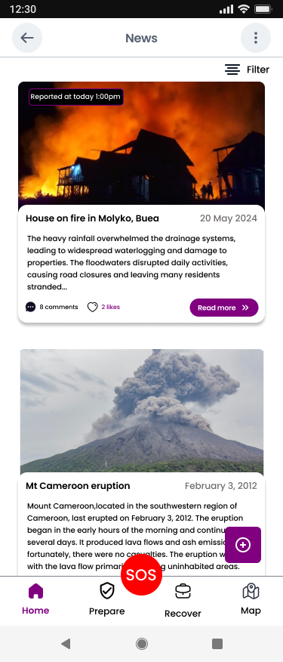
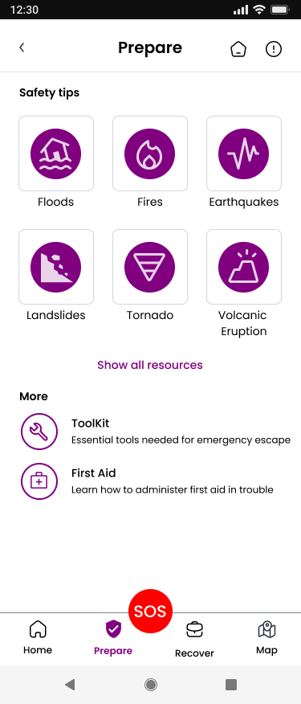
Key Features
Newsfeed
Report Incident
Educational resources

Slide 9
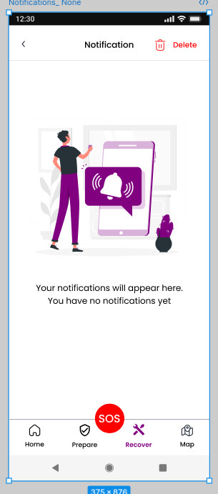
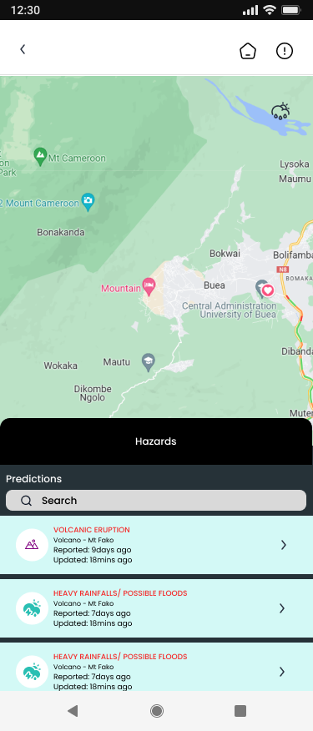
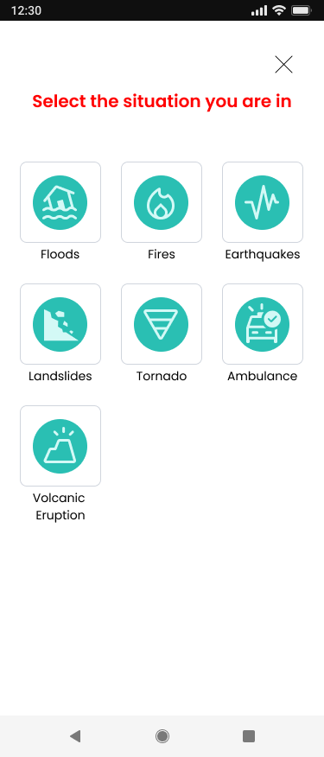
Map API
Emergency contact
Notifications

Slide 10
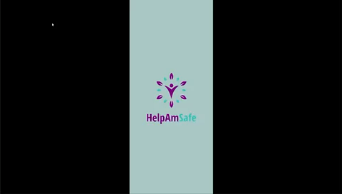

Slide 11
Implementation Details
3
Explaining the overall architecture of the app, providing insights into the organization and structure of the app's codebase

Slide 12
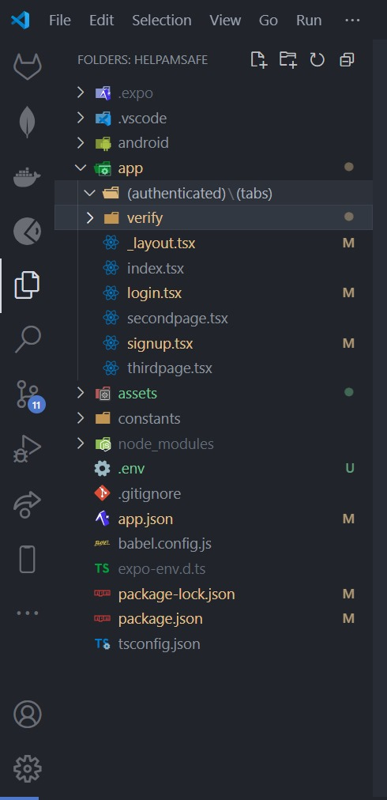
Folder Structure

Slide 13
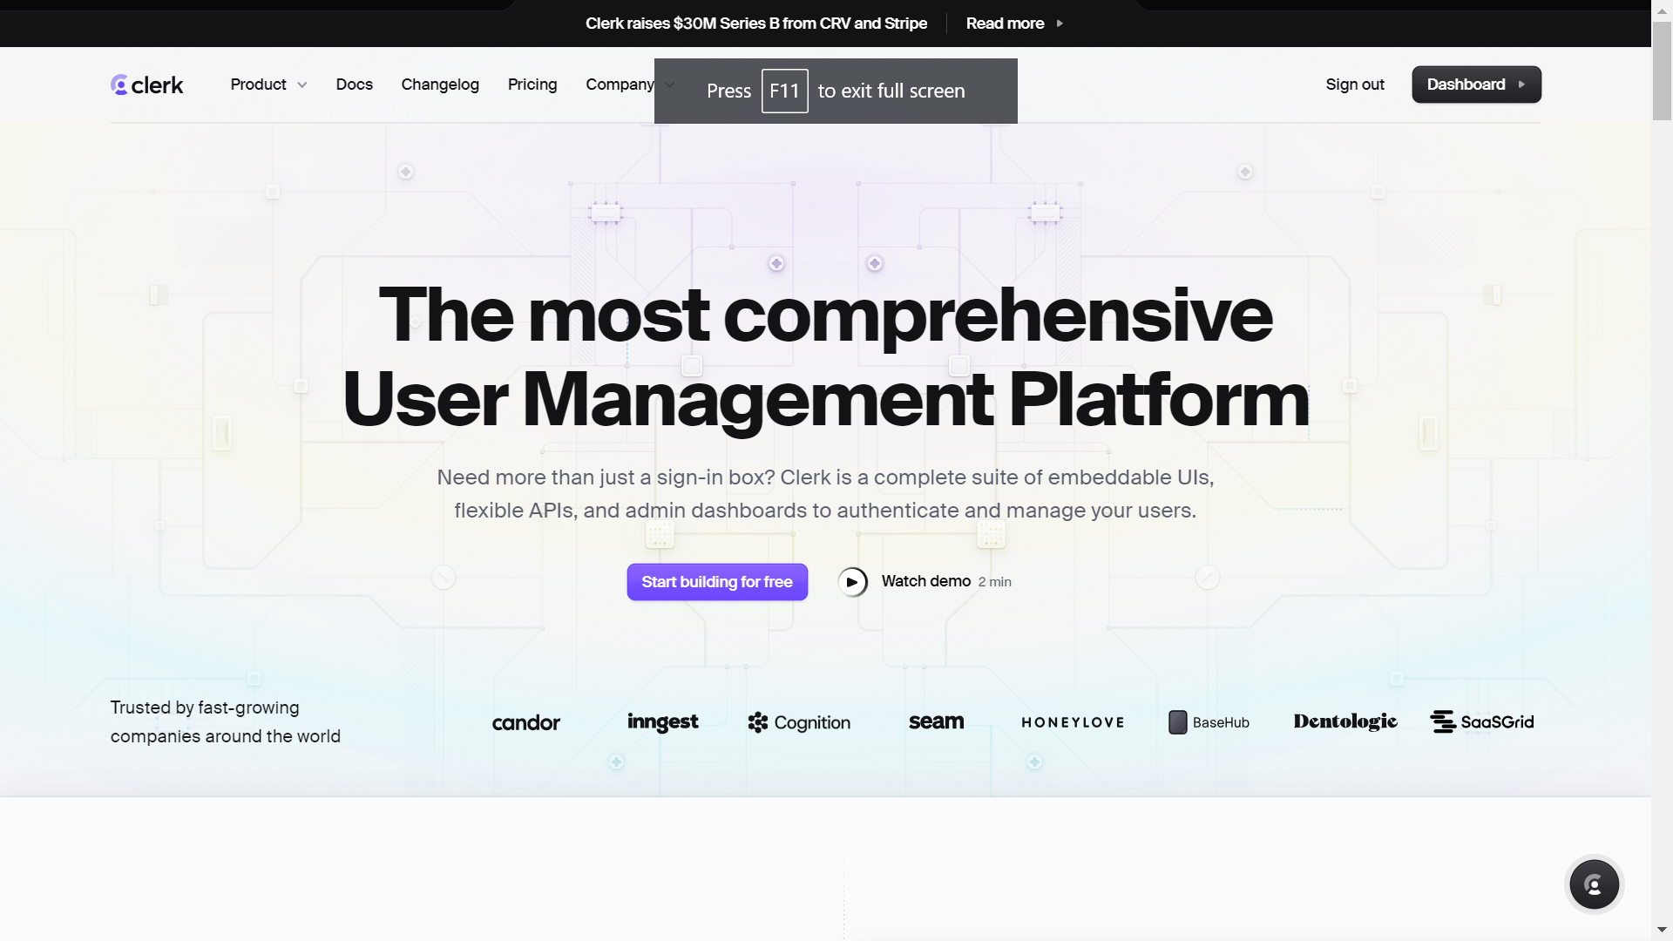
Clerk - User Management

Slide 14
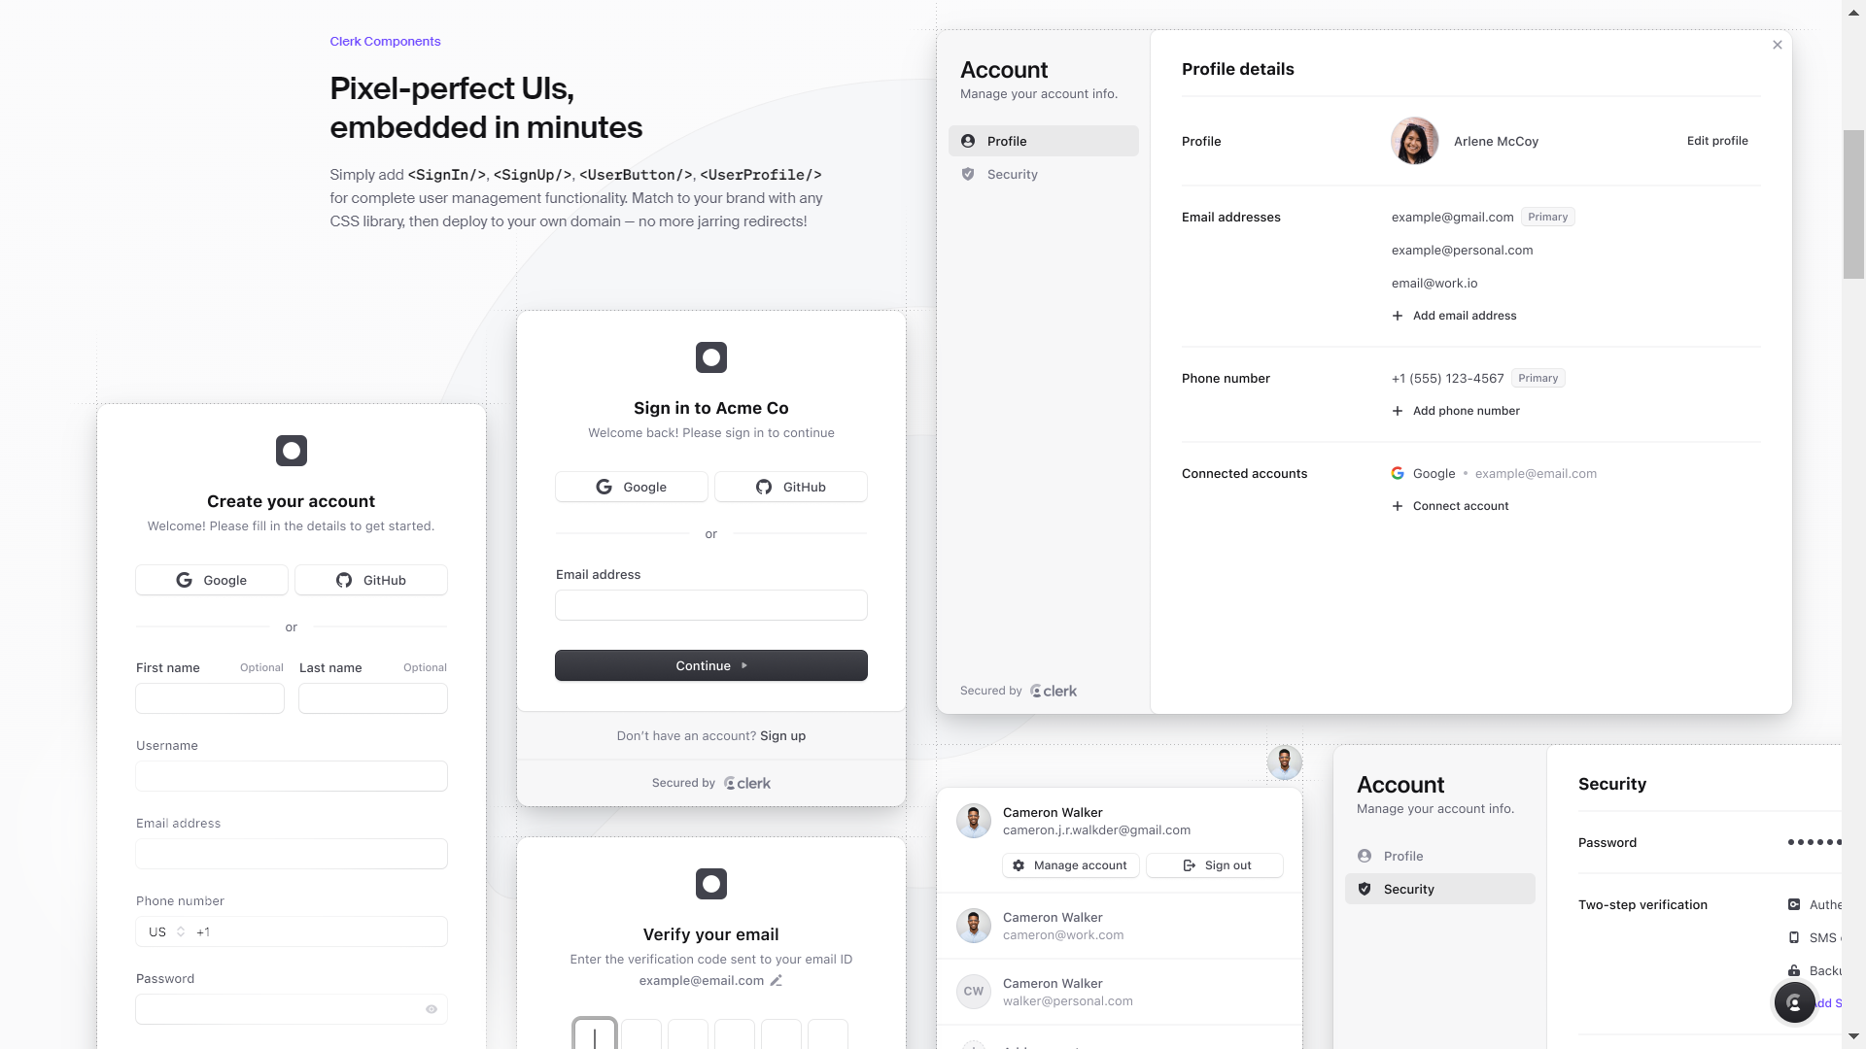

Slide 15
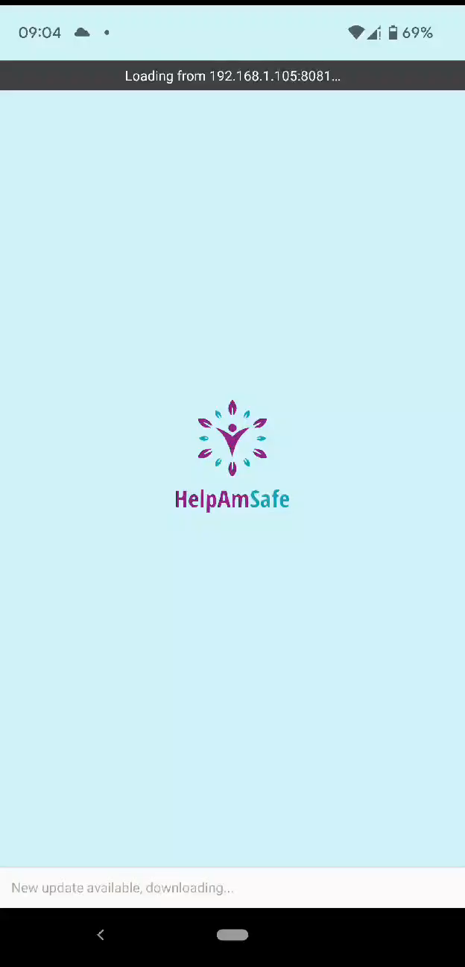
Sample UI Implementation

Slide 16
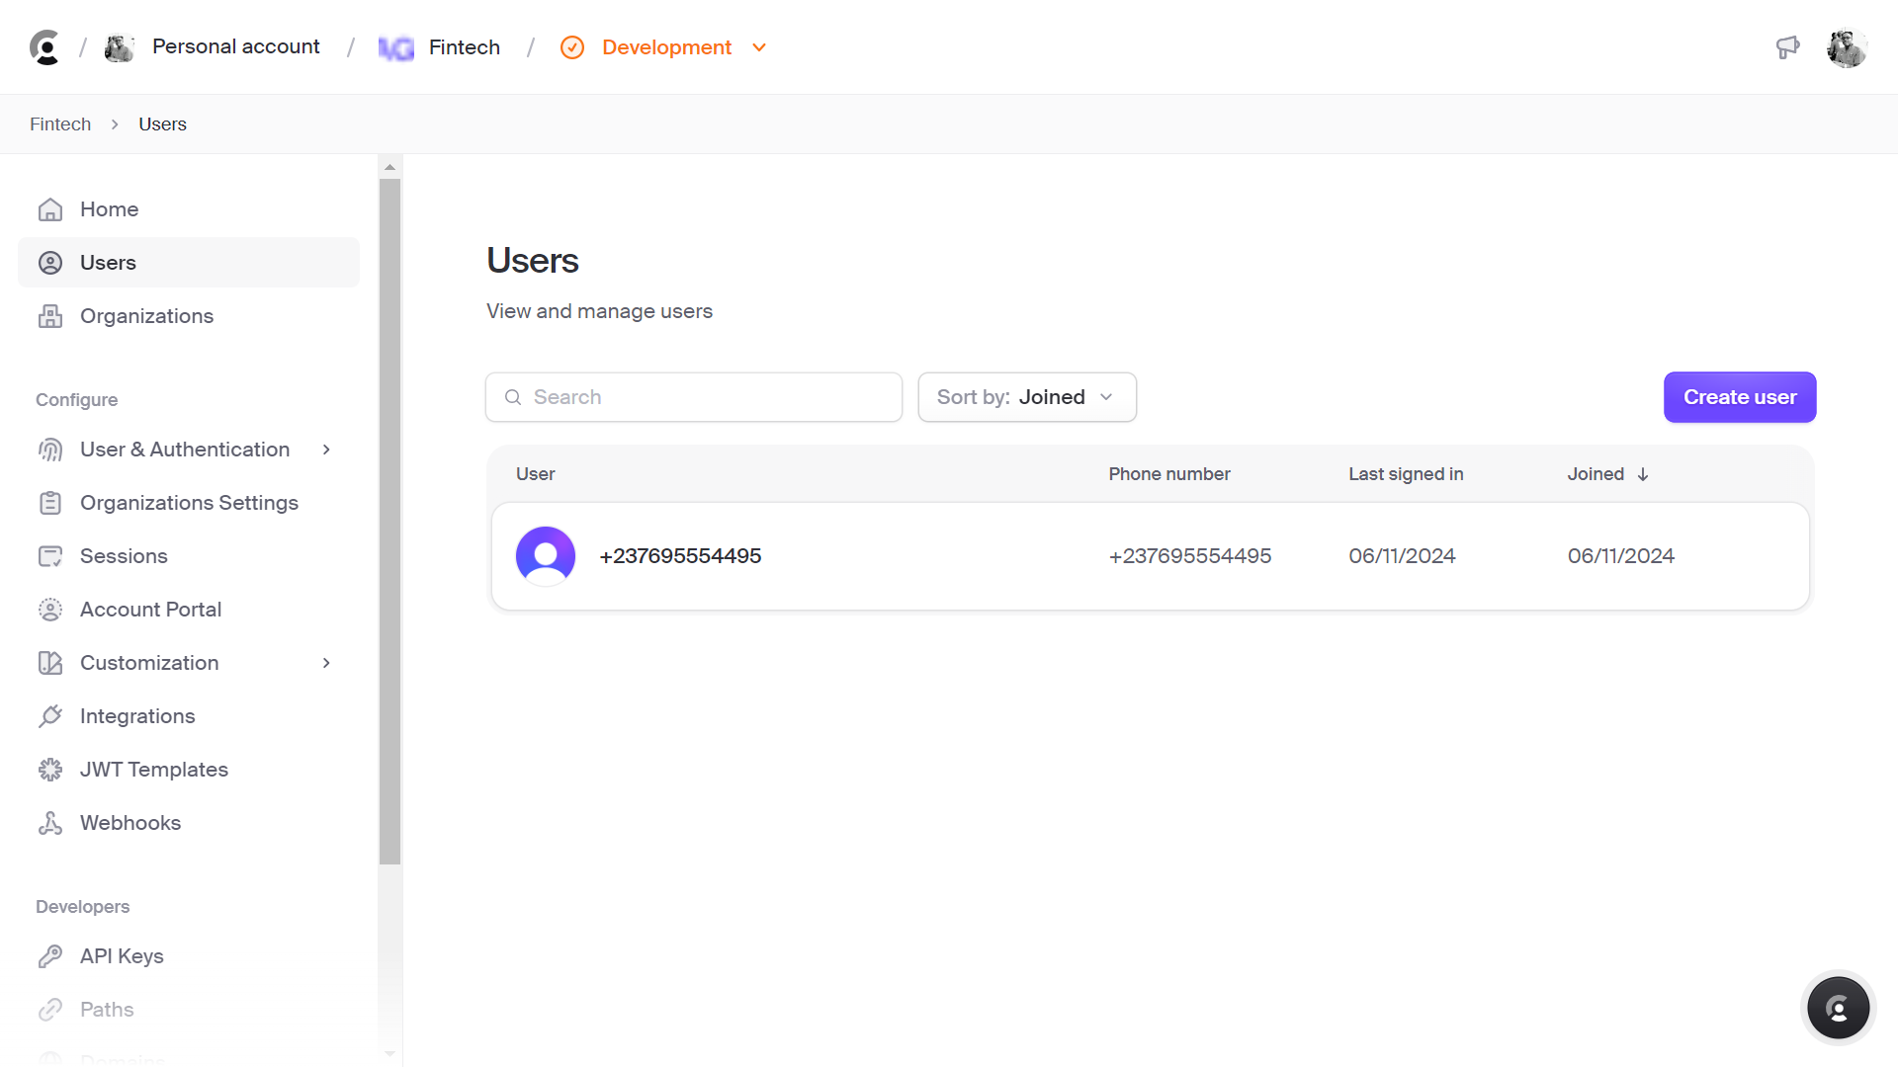

Slide 17
Testing &
Quality Assurance
4
Describing the testing methods used to ensure the functionality, performance, and usability of the app

Slide 18
Category of Tests performed
Visual Design
Technical
1
2
Usability Test
Functional Test

Slide 19

Is the interface intuitive and easy to use?
Can users easily access core features?
Is the information clear and understandable?
Does the interface meet user expectations?
Are there any visual or functional issues?
Usability Testing:

Slide 20

Functional Testing:
Validate Core Functionalities in client-side code
Detect Defects in the User Interface Design
Stability Under various conditions (error handling)

Slide 21
Deployment & Maintenance
5
Outlining the steps involved in deploying the app to production environments, describing the plan for ongoing maintenance and support of the app

Slide 22
DEPLOY PROCESS
1
2
3
4
Build Preparation
CI/CD Integration
Staging Deployment
Production Deployment

Slide 23
Maintenance Plan
1
2
3
4
Security Patches
Feature Enhancements
User
Analytics
Bug Fixes

Slide 24
Conclusion
By following our structured plan and providing comprehensive user support, we ensure our disaster management mobile application remains reliable, secure, and user-friendly, effectively aiding in emergency situations

